Slide 1
Iris Species Model
EELU Machine learning project

Slide 2
Team name
-محمد حسام إبراهيم بكر 2202115
-يوسف أحمد عجيب سالم 2202112
-محمد محمود احمد 2202033
-توفيق محمد توفيق 2202020
-احمد محمد احمد سليمان 2202049
-أميرة سيد ناصر 2200044
-فرونيا ايهاب رشدي 2200786

Slide 3
Project introduction
The Iris dataset is a classic dataset in the field of machine learning.
Published by R.A. Fisher in 1936 in the paper "The Use of Multiple Measurements in Taxonomic Problems."
Significance: Demonstrates the use of statistical techniques for classification.
Objective of the Project
The goal of this project is to classify iris plants into three species based on their characteristics.
The dataset includes measurements of sepal length, sepal width, petal length, and petal width.

Slide 4
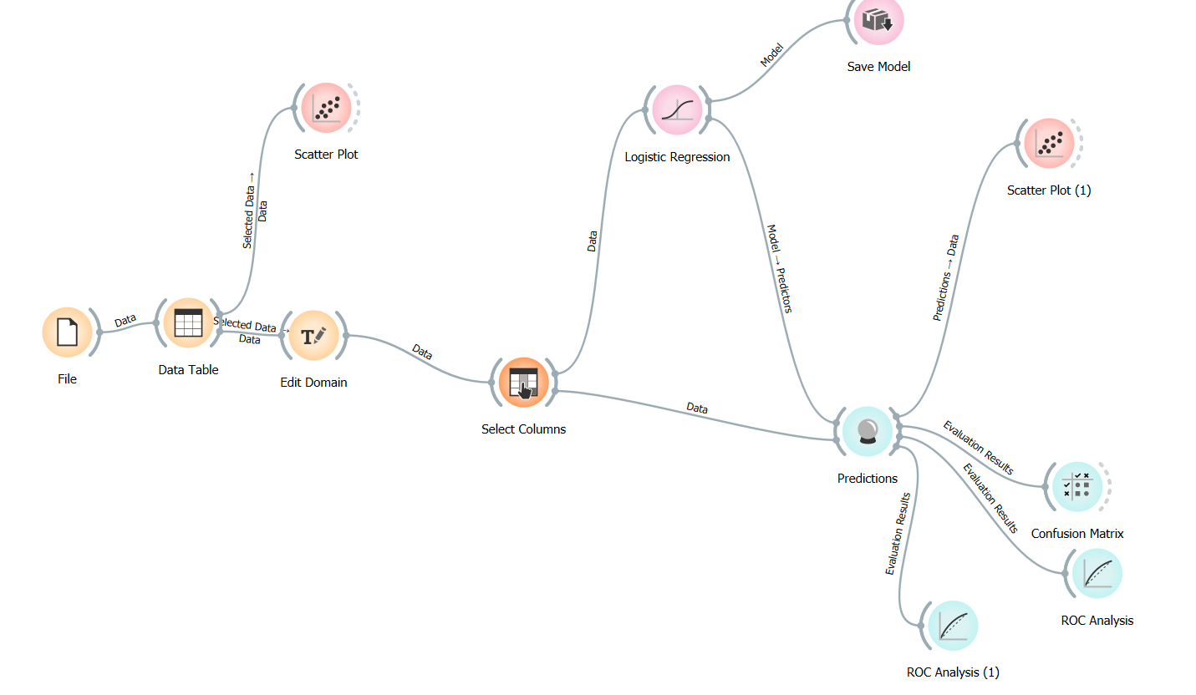
Project overview

Slide 5
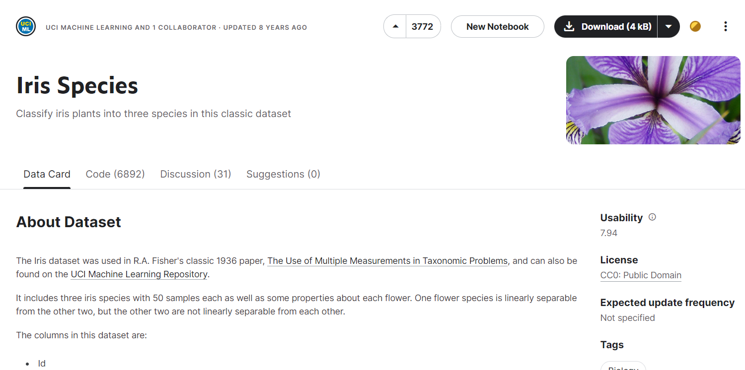
Dataset Overview

Slide 6
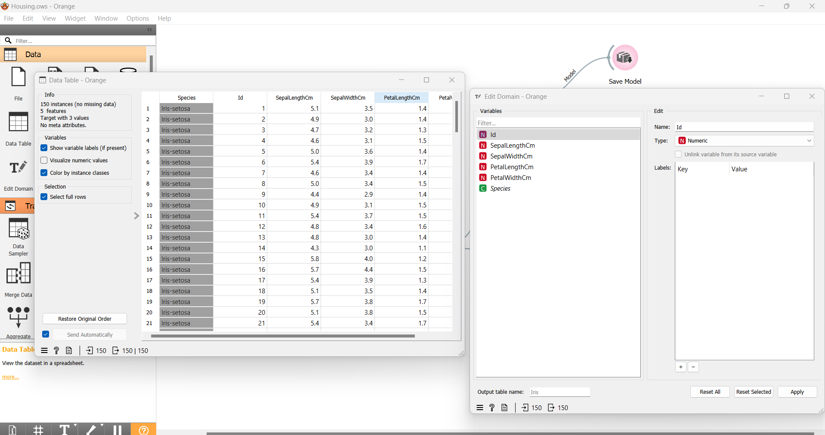
Data Preprocessing
1. Handling Missing Values (if any)
Check for any missing or null values in the dataset.
If there are missing values, decide on a strategy to handle them:
2. Encoding Categorical Variables
The target variable "Species" is categorical (Setosa, Versicolor, Virginica).
Convert categorical labels into numerical format suitable for machine learning algorithms:
Use label encoding (assigning numeric labels to categories).
Alternatively, use one-hot encoding for nominal variables.
3. Splitting the Dataset
Divide the dataset into training and testing sets:
Typically, use a split such as 80% for training and 20% for testing.

Slide 7
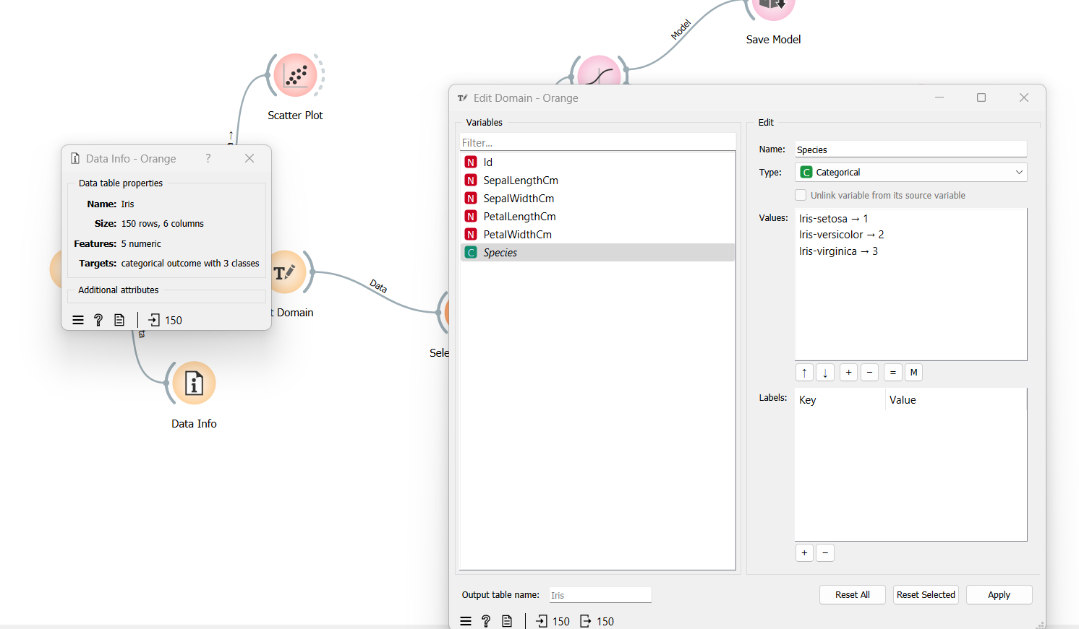
Exploratory Data Analysis (EDA)
2. Data Visualization
Utilize plots and charts to visualize relationships and distributions:
Scatter plots: Sepal length vs. Sepal width, Petal length vs. Petal width (colored by species).
Histograms: Distribution of each feature (Sepal length, Sepal width, Petal length, Petal width) by species.
Box plots: Feature distributions and outliers across species.
3. Insights from EDA
Extract insights and observations from the visualizations:
Identify patterns or correlations between features and species.
Determine if certain features are more discriminative for species classification.

Slide 8
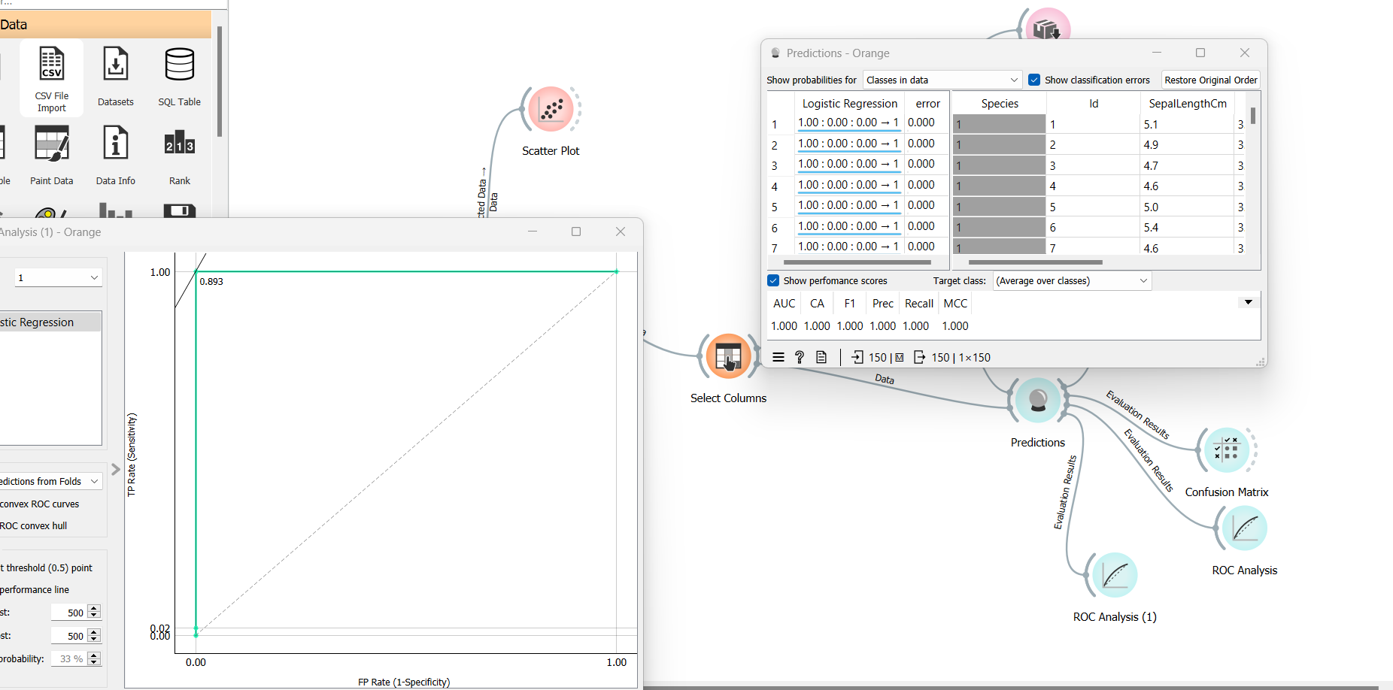
Model selection

Slide 9
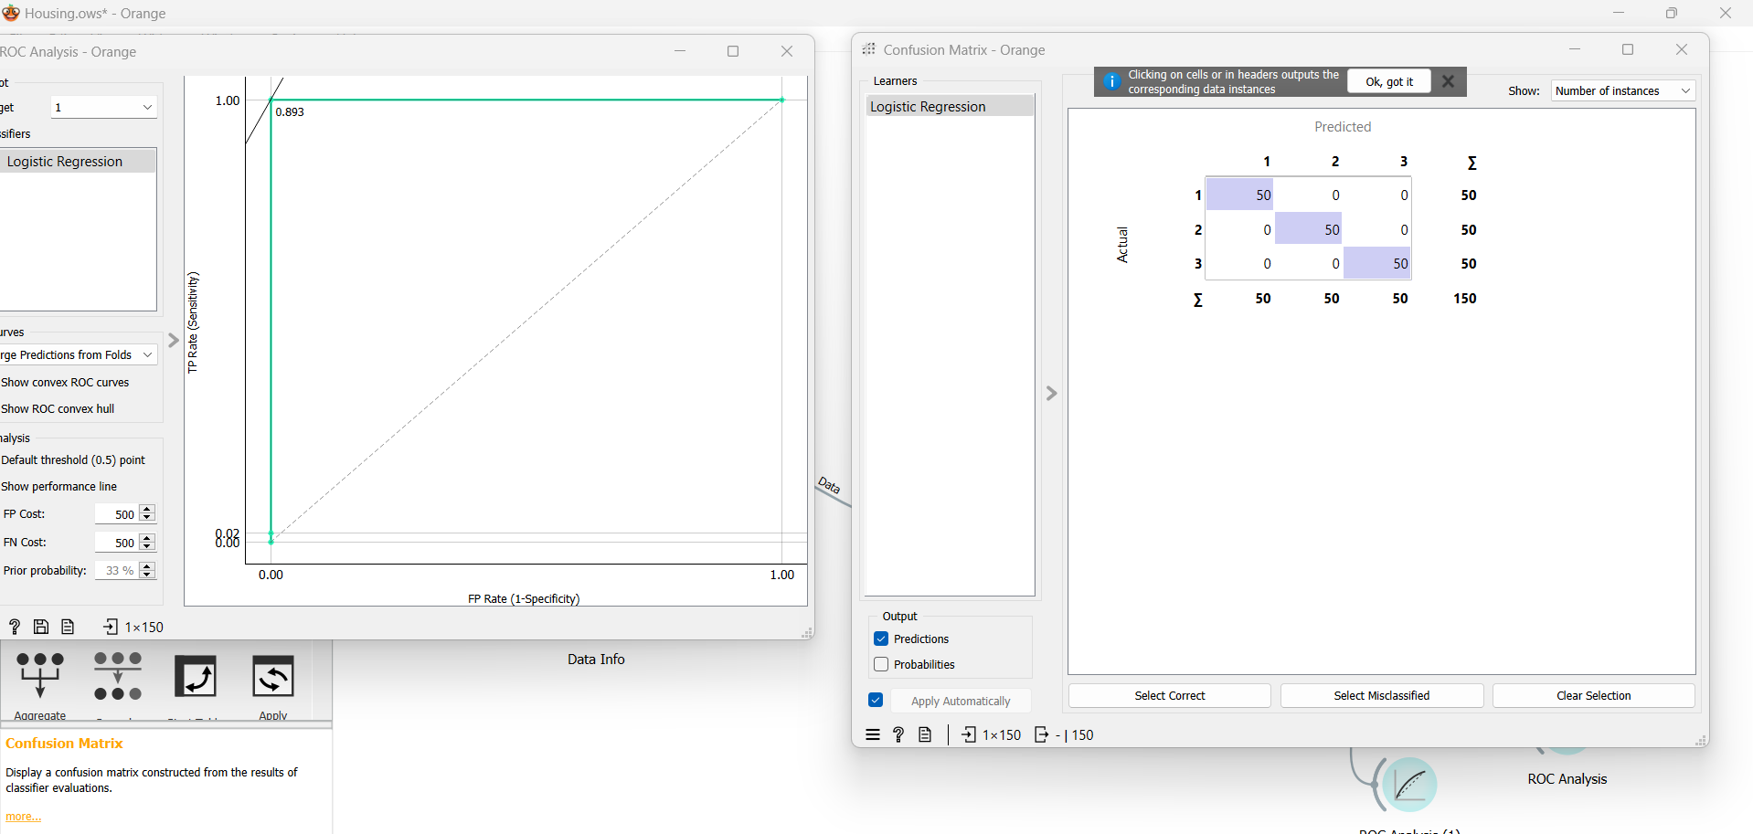
Evaluation

Slide 10
Thank you

